Slide 1
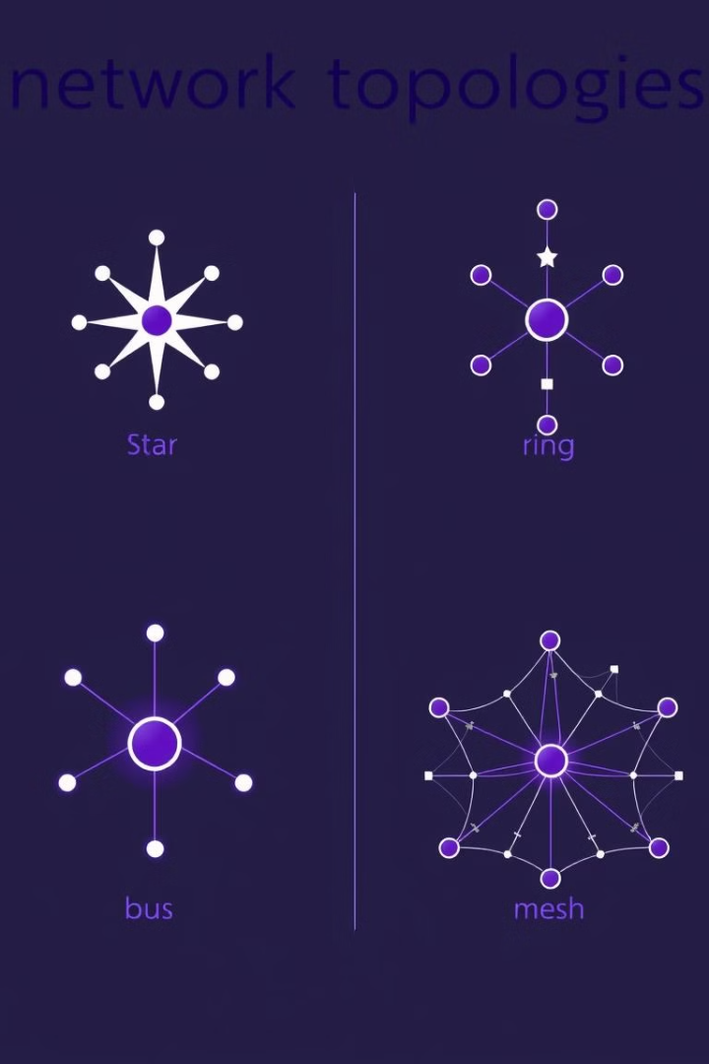
Network Topologies: A Deep Dive
Welcome to our exploration of network topologies, the fundamental building blocks of any computer network.

Slide 2
What are Network Topologies?
Network Structure
Communication Patterns
Physical vs. Logical
A topology defines the arrangement of network devices and how they communicate.
It outlines the pathways data travels between connected devices within a network.
Topologies can be physical, reflecting the actual cabling, or logical, representing the data flow.

Slide 3
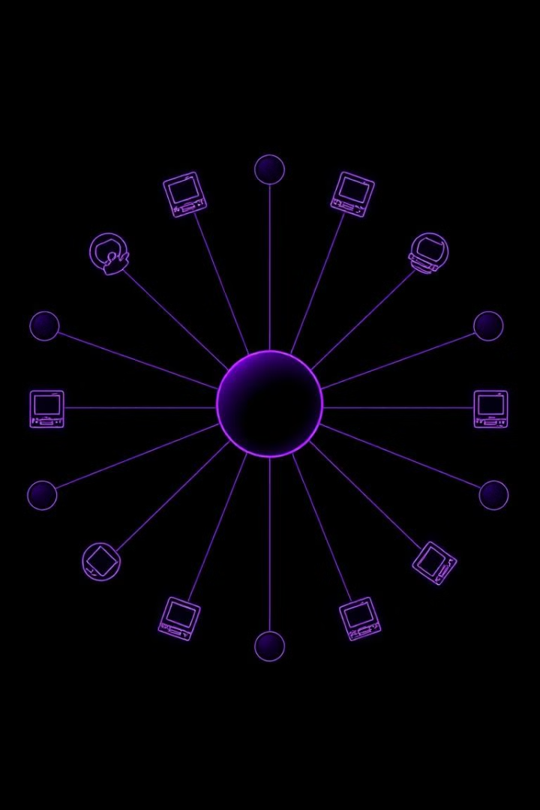
Star Topology
1
Central Hub
2
Point-to-Point
All devices connect to a central hub or switch.
Data flows through the hub, providing dedicated communication paths.
3
Easy Management
4
Single Point of Failure
Centralized hub makes troubleshooting and administration simpler.
If the hub fails, the entire network goes down.

Slide 4

Bus Topology
1
Shared Medium
2
Simple Setup
All devices share a single cable or bus to transmit data.
Relatively easy and inexpensive to implement, making it suitable for small networks.
3
Limited Bandwidth
4
Difficult Troubleshooting
Collisions can occur when multiple devices transmit at the same time, reducing network efficiency.
Identifying the source of network issues can be challenging.

Slide 5
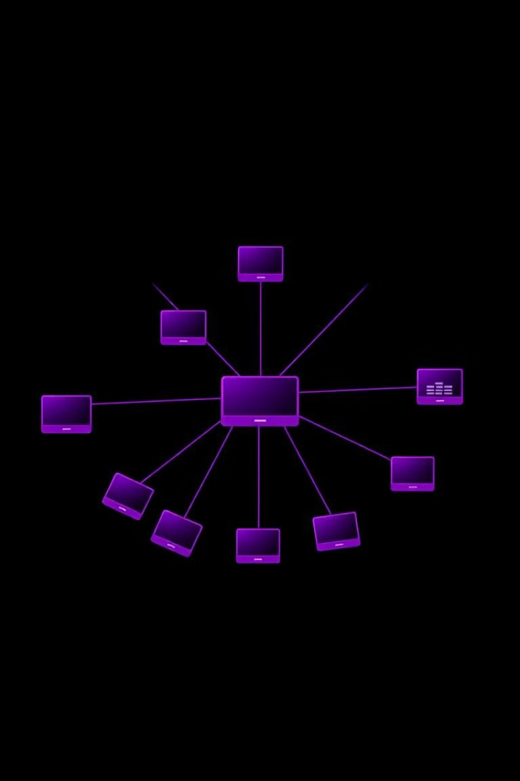
Ring Topology
1
Circular Data Flow
2
High Bandwidth
Data travels in a circular path, passing through each device in the ring.
Data flows efficiently without collisions, as only one device transmits at a time.
3
Single Point of Failure
4
Difficult to Add Devices
If one device or connection fails, the entire network is disrupted.
Adding or removing devices requires network downtime.

Slide 6

Tree Topology
1
Hierarchical Structure
2
Easy Expansion
New branches can be added easily, making it suitable for large networks.
Devices are connected in a hierarchical manner, resembling a tree with branches.
3
Centralized Control
4
Single Point of Failure
A central root node manages the network, simplifying administration and troubleshooting.
If the central node fails, the entire network is disrupted.

Slide 7
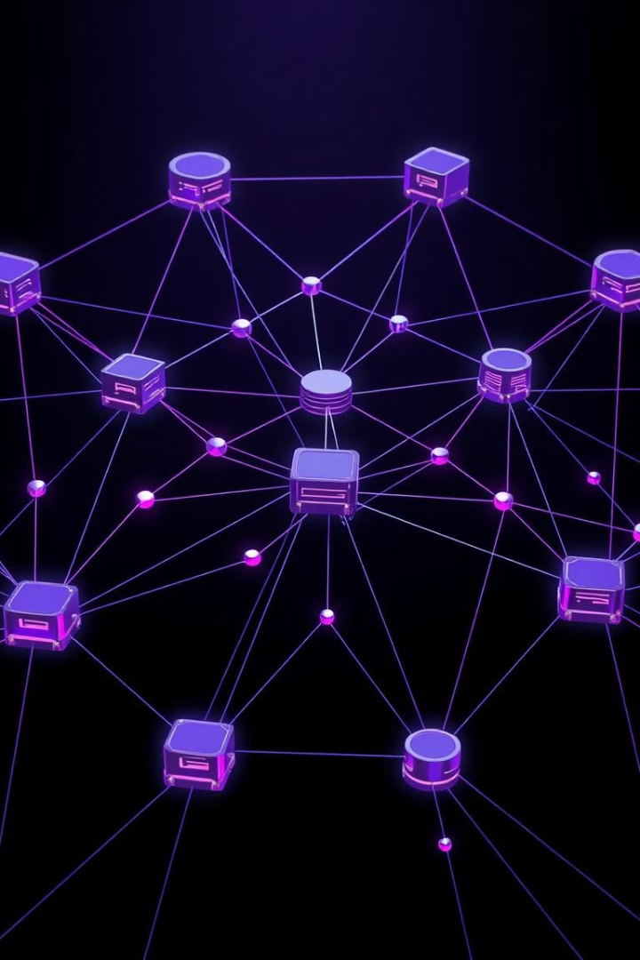
Mesh Topology
1
Redundant Connections
2
High Fault Tolerance
The network can continue functioning even if some devices or connections fail.
Each device has multiple connections to other devices, ensuring high reliability.
3
Complex Setup
4
Increased Bandwidth
Implementing a mesh network is more challenging and expensive than other topologies.
Redundant paths allow data to flow efficiently even during heavy network traffic.

Slide 8
Advantages and Disadvantages of Topologies
Star Topology
Bus Topology
Ring Topology
Pros: Easy management, high bandwidth, scalability. Cons: Single point of failure, expensive.
Pros: Simple setup, cost-effective. Cons: Limited bandwidth, difficult troubleshooting, prone to collisions.
Pros: High bandwidth, efficient data flow. Cons: Single point of failure, difficult to add devices.

Slide 9





Choosing the Right Topology for Your Network
Network Size
1
Small networks may suit simpler topologies, while larger networks benefit from more complex setups.
2
Budget
Cost considerations are crucial, as some topologies require more expensive equipment or installation.
3
Reliability
Fault tolerance is essential for critical systems, and some topologies offer greater redundancy.
Performance
4
Network speed and efficiency are crucial factors, with some topologies optimized for high bandwidth.
5
Scalability
The ability to expand the network in the future is a key factor for growing organizations.

Slide 10

Conclusion and Key Takeaways
1
Topology Choice
2
Trade-offs
Selecting the appropriate topology is crucial for network performance, reliability, and scalability.
Every topology has its advantages and disadvantages, and the best choice depends on specific needs.
3
Future Networks
Understanding network topologies is essential for managing and evolving your network as technology progresses.

